Slide 1
SENSOR NETWORKS

Slide 2
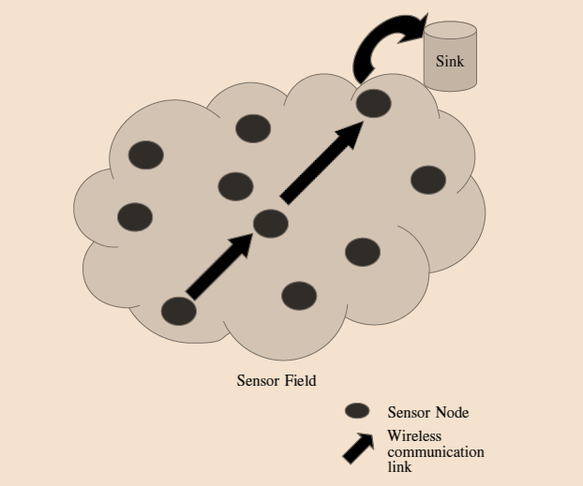
Wireless Sensor Networks
Sensor Node
Sensing
Data processing
Computation
Comm/networking
Sensor networks are built using a large number of densely deployed sensor nodes

Slide 3
Wireless Sensor Networks
Deployments
Collection of data
On the ground
Underground
Air
Underwater
On human bodies
In vehicles
Inside building structures
Periodic
Threshold based
Query based
Event triggered
Combination of above

Slide 4
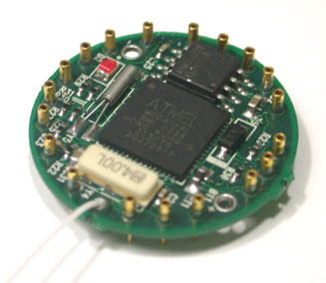
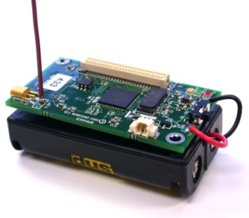
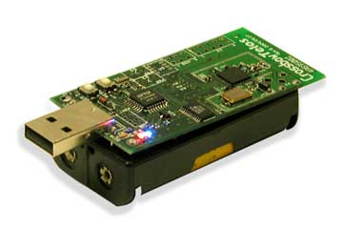
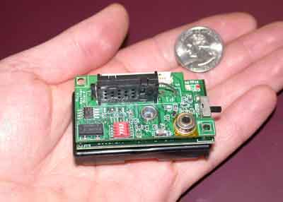
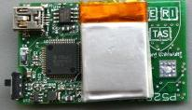
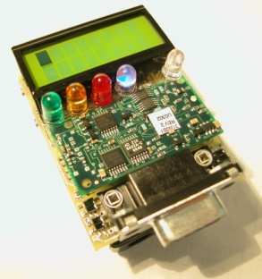
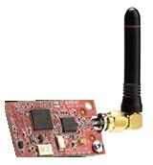
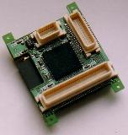
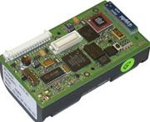
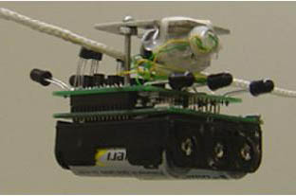
Enabling Technology?
Processor | ATmega128, 8-bit, 16MHz
RAM | 4KB
Program Memory | 128KB
External Flash Memory | 512KB
Radio Transceiver | (60kbps, 250kbps)
Lifetime (2AA, no duty-cycle) | ~6 days
Operating Environment | Untethered, Harsh
Mica Dot
Telos
Mica2
Pluto
ETag
Mica Mote
EmberNet
DSYS25
BT Node
XYZ

Slide 5
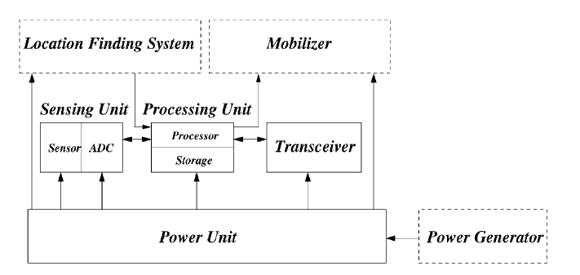
Node structure

Slide 6
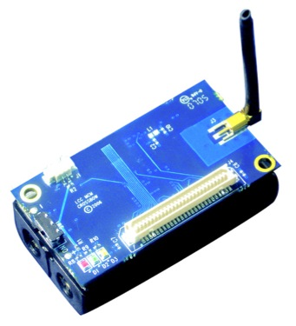
Sensor Node Hardware
1Kbps - 1Mbps,
3-100 Meters,
Lossy Transmissions
Transceiver
Memory
Embedded
Processor
128KB-1MB
Limited Storage
Sensors
Battery
Limited Lifetime
Energy Harvesting System

Slide 7

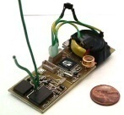






Sensor nodes are
usually scattered in the sensor field in an infrastructure-less ad hoc architecture
Radio
Power
Processor
Sensors
Memory

Slide 8
The position of sensor nodes need not be engineered or pre-determined.
This allows random deployment in inaccessible terrains or disaster relief operations.
On the other hand, this also means that sensor network protocols and algorithms must possess self-organizing capabilities.

Slide 9
After Deployment

Slide 10
After Deployment

Slide 11
After Deployment

Slide 12
After Deployment

Slide 13
After Deployment

Slide 14
Topology of WSN
Ideally – large number of low cost nodes
Pre-deployment Should
eliminate the need for any pre-organization and pre-planning,
increase the flexibility of arrangement, and
promote self-organization and fault tolerance.
Post deployment topology changes would happen
Malfunctioning
Battery/energy depletion
Communication barriers/issues
Movement of nodes/Environment conditions
Re-deployment of additional nodes

Slide 15
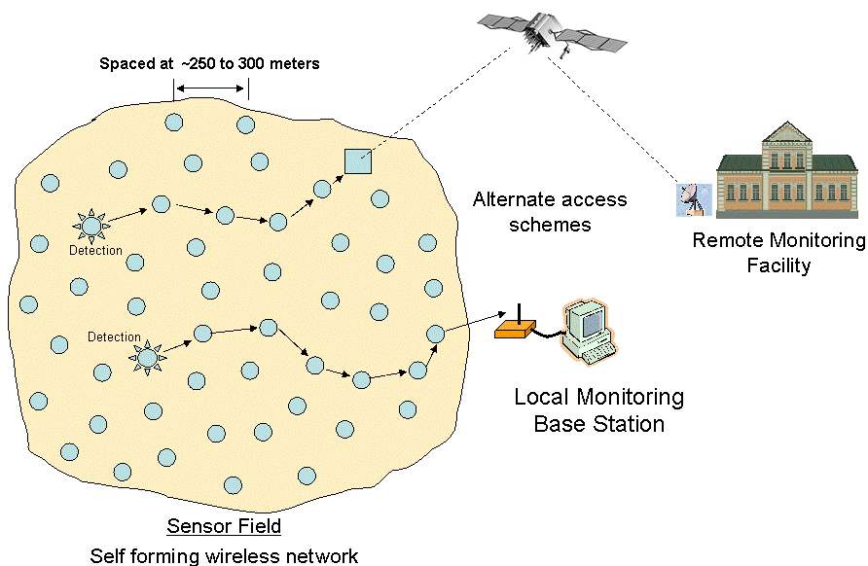
Wireless Sensor Networks (WSNs)
10 to 100

Slide 16
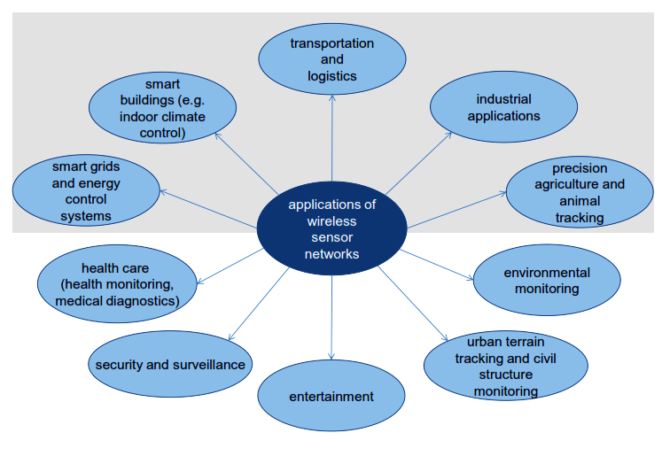
Fields of Application of WSNs

Slide 17
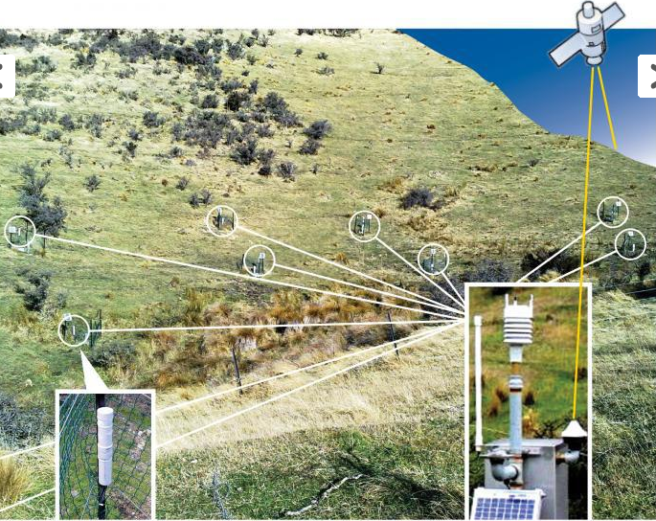
Environmental observation
Sensor data is transferred from each monitoring site to a CWS then uploaded to the Neon Server via satellite.
The remote wireless interfaces are enclosed in sealed tubes (bottom left) and the soil moisture and water level sensors are wired directly to them.
Source: SMARTi
https://www.niwa.co.nz

Slide 18
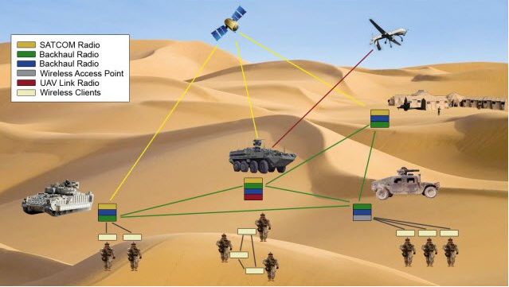
Military monitoring
Battlefield surveillance; sensors could monitor vehicular traffic, track the position of the enemy or even safeguard the equipment of the side deploying sensors.
Source: https://www.elprocus.com

Slide 19
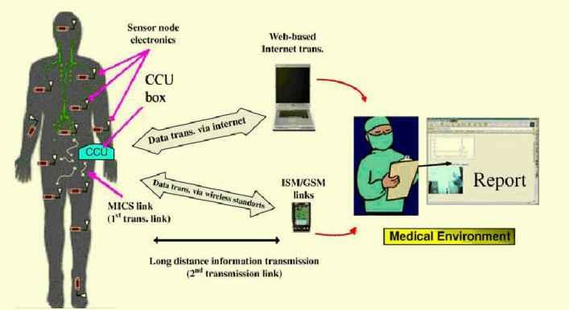
Healthcare
System transmitting module continuously reads patient’s body temperature through a digital temperature sensor, displays it on the LCD screen and sends it to the microcontroller which transmits the encoded serial data over the air by RF through an RF module.
Source: https://www.elprocus.com

Slide 20
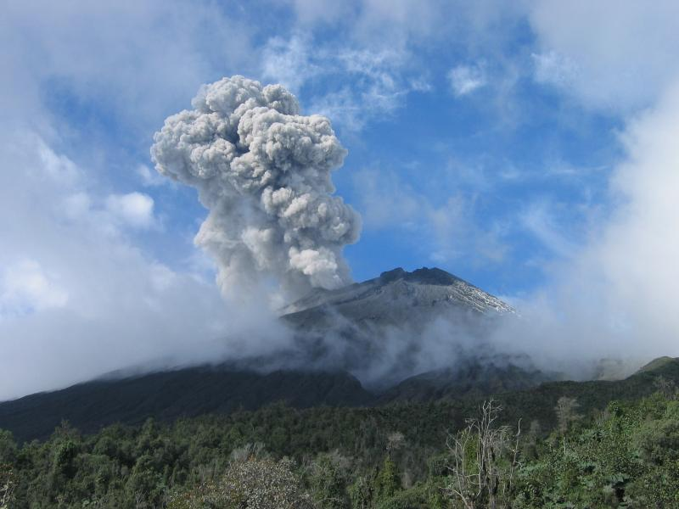
Environmental/Events monitoring

Slide 21

Structural monitoring

Slide 22
Power consumption
In some application scenarios, replenishment of power resources might be impossible.
Sensor node lifetime, therefore, shows a strong dependence on battery lifetime.
In a multihop ad hoc sensor network, each node plays the dual role of data originator and data router.
The disfunctioning of few nodes can cause significant topological changes and might require re-routing of packets and re-organization of the network.
Hence, power conservation and power management take on additional importance.

Slide 23
Power consumption
Sensing – Application specific
Data Processing – Minimal consumption
Communication – Maximum Energy
Transmission
Reception

Slide 24
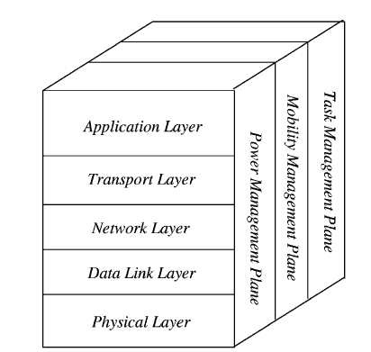
WSN protocol stack
These management planes are needed, so that sensor nodes can work together in a power efficient way, route data in a mobile sensor network, and share resources between sensor nodes.
Without them, each sensor node will just work individually.
From the whole sensor network standpoint, it is more efficient if sensor nodes can collaborate with each other, so the lifetime of the sensor networks can be prolonged.

Slide 25
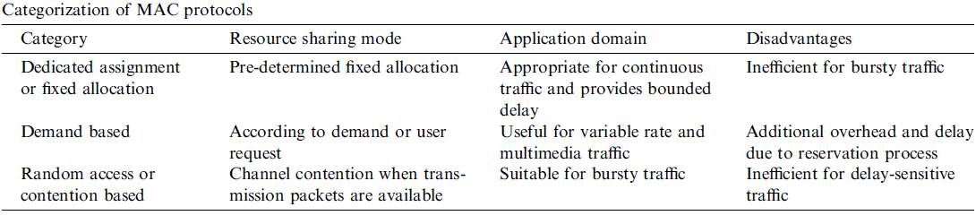
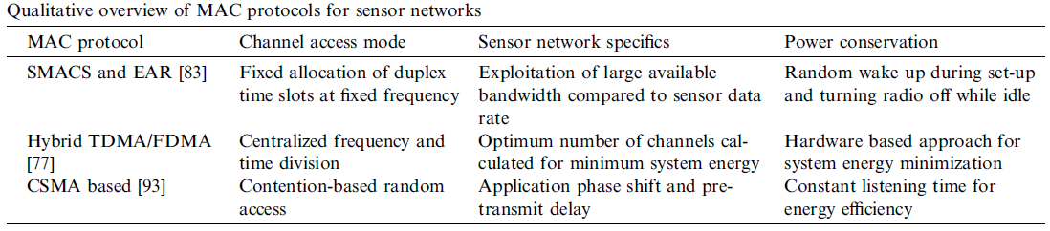

Slide 26
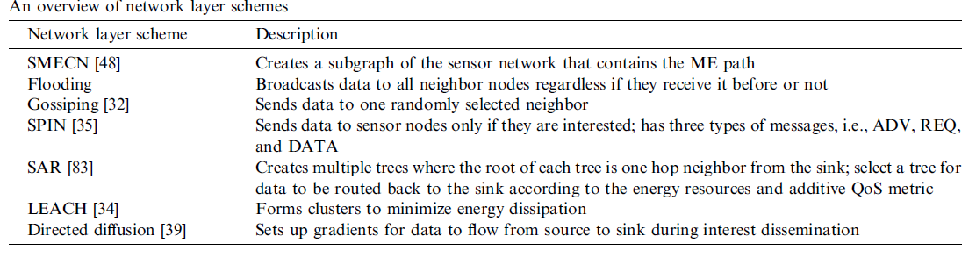
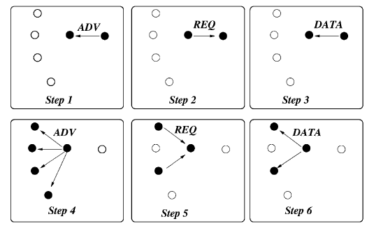
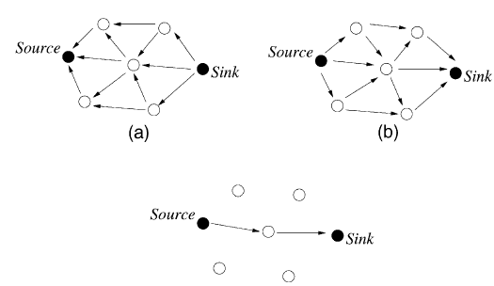

Slide 27
Research in WSN protocol stack
Realization of sensor networks needs to satisfy the constraints introduced by factors such as fault tolerance, scalability, cost, hardware, topology change, environment and power consumption.
Since these constraints are highly stringent and specific for sensor networks, new wireless ad hoc networking techniques are required.
Many researchers are currently engaged in developing the technologies needed for different layers of the sensor networks protocol stack.

Slide 28
COMING BACK TO OUR WORK

Slide 29
Sensor Networks for monitoring, disaster rescue operations

Slide 30
3D mobile ad-hoc networks
Aerial networks
Use of UAVs (drones)
Platforms –
NS3 + ROS
CPP + Python
https://www.ros.org/about-ros/
https://www.nsnam.org/documentation/
Underwater networks
Use of AUV (Gliders, miniature vehicles, submarines etc.)
Platforms –
Unetsim (Java based)
https://unetstack.net/

Slide 31

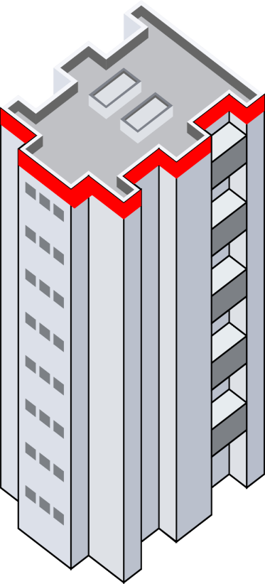



uav_message
My_ID | 9
My_Pos | 9_Position
Dst_ID | 100 (Unicast)
Nbr_table | (8,100)
Type of MSG | Generic
Control | 0 0000 0000
State | 10 0010
P_ID | -
P_ID_Pos | -
4
6
2
1
8
7
9
5
3

Slide 32

2
1
ROS
Feed New position to Drone
Step - 4
ROS
Get Position and time from GPS of Drone
Step - 1
ROS – NS3 communication link
NS3
Receive message and Extract data fields including new position
Step - 3
NS3
Convert position and time data along with ID, direction and Rc into message and Transmit
Step - 2

Slide 33
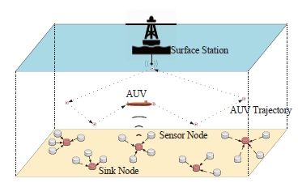
Underwater network

Slide 34
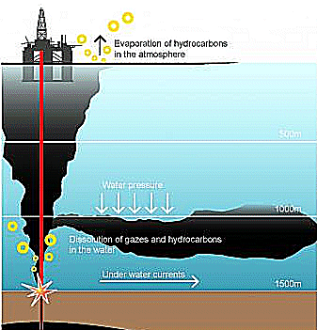
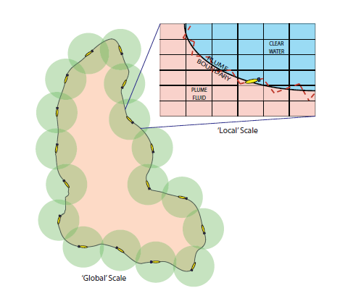
Ocean phenomenon/Plume monitoring

Slide 35
